Slide 1

bit.ly/3MXxL1g

Slide 2
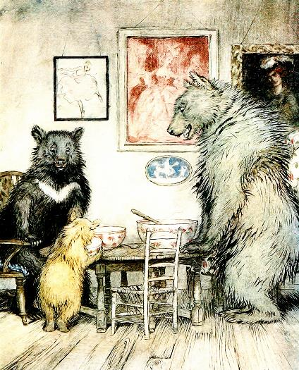
Goldilocks and the three business bears;
story telling for business
Notes:
https://publicdomainpictures.net/en/view-image.php?image=194409&picture=the-three-bears

Slide 3
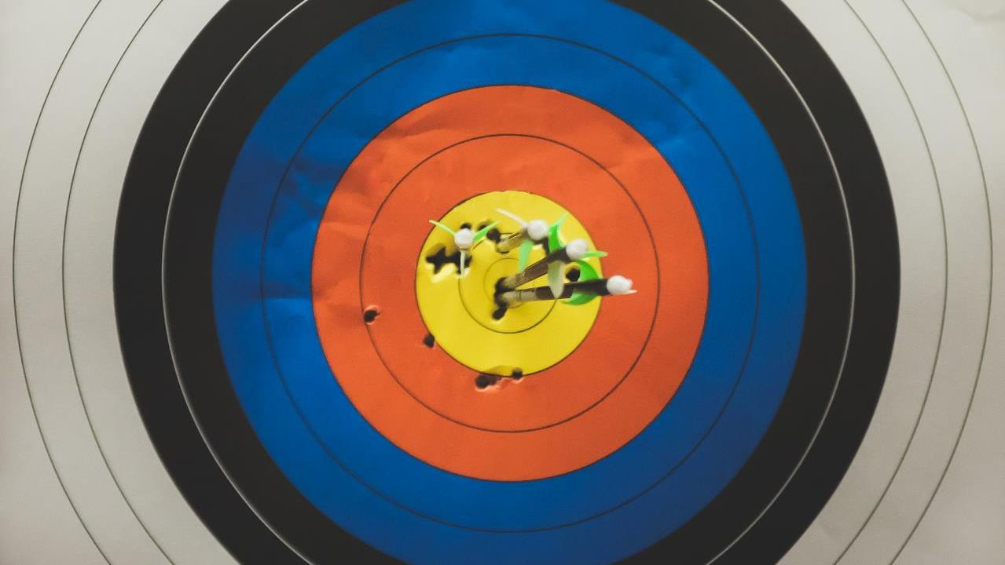
Notes:
Photo by Kenny Eliason on Unsplash
What is my goal today?

Slide 4

Notes:
Photo by Elevate on Unsplash
To give people a flavor of a number of topics

Slide 5

Notes:
Photo by Markus Winkler on Unsplash

Slide 6

Notes:
Photo by Markus Winkler on Unsplash

Slide 7

Notes:
Photo by Kate Oseen on Unsplash
Lets talk about those opinions first

Slide 8
Storytelling has no place in business

Slide 9

Notes:
Photo by Pixabay: https://www.pexels.com/photo/question-mark-on-chalk-board-356079/
A few questions

Slide 10
In 2019 which industry had a market share of > $100 billion

Slide 11

Notes:
Photo by Martin Lopez: https://www.pexels.com/photo/man-holding-clapper-board-1117132/

Slide 12

Notes:
Photo by Susan Wilkinson on Unsplash
What about fiction books

Slide 13
People do not buy goods and services.
They buy relations, stories and magic.
Seth Godin

Slide 14
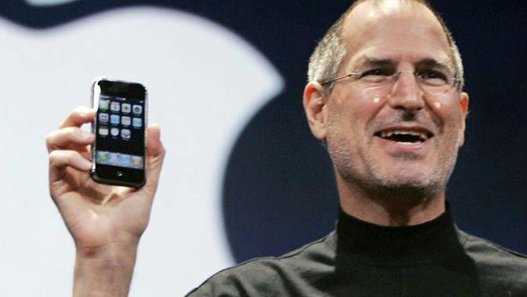
Notes:
https://www.flickr.com/photos/kimstovring/15670878201

Slide 15
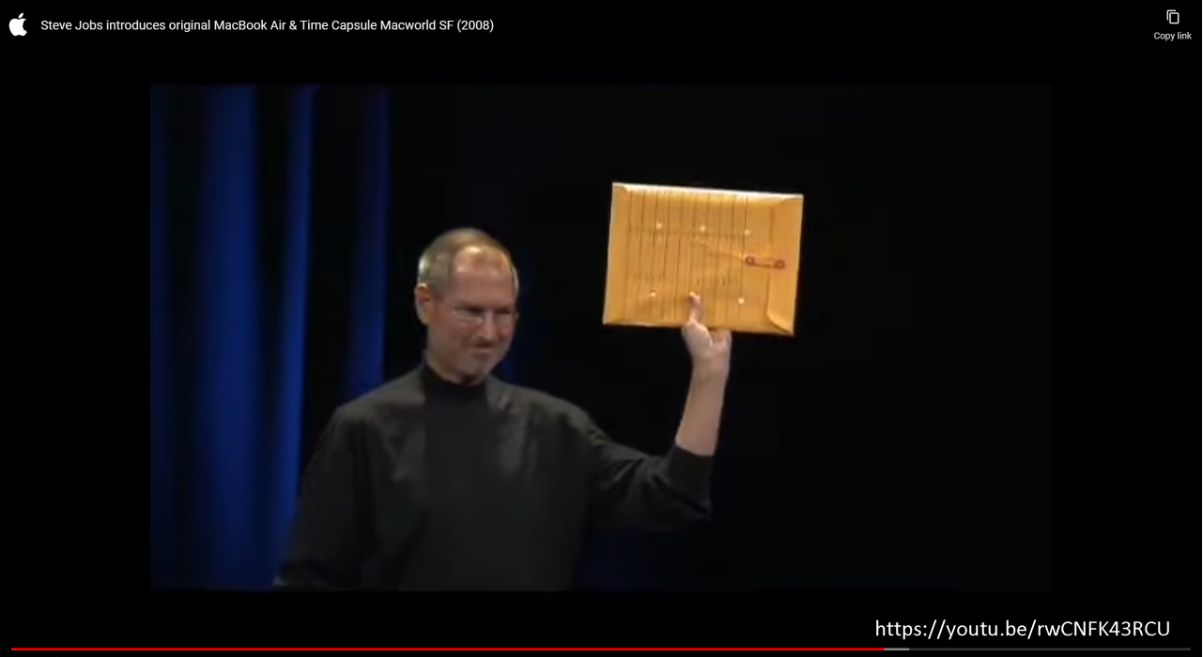

Slide 16

Notes:
https://www.maxpixel.net/Apple-Iphone-8-Smartphone-Apps-Application-App-3d-4389881

Slide 17
Data stories don't change peoples’ minds

Slide 18

Notes:
Photo by Mikael Seegen on Unsplash
This next section is a little controversial

Slide 19
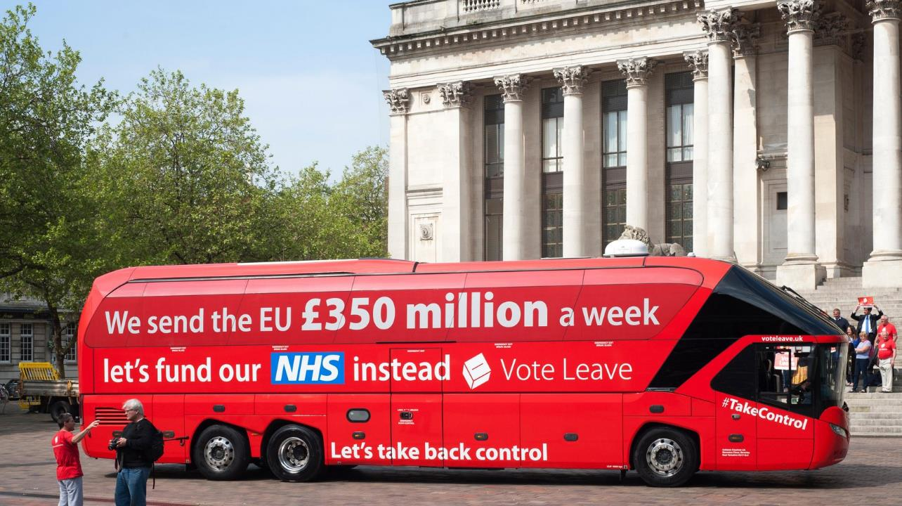
Notes:
Ordered by:- rwlp.french@gmail.com
Order reference- OY67246107

Slide 20
Story
Notes:
Ordered by:- rwlp.french@gmail.com
Order reference- OY67246107

Slide 21
Story
Data
Notes:
Ordered by:- rwlp.french@gmail.com
Order reference- OY67246107

Slide 22
Story
Data
Narrative
Notes:
Ordered by:- rwlp.french@gmail.com
Order reference- OY67246107

Slide 23
Story
Data
Narrative
Call to action
Notes:
Ordered by:- rwlp.french@gmail.com
Order reference- OY67246107

Slide 24

Notes:
There is more

Slide 25
“…Two-thirds of leave supporters still believe the discredited claim that the UK sends £350 million per week to the EU, compared with only one in five remain supporters……"
(from "The Perils of Perception: Why We’re Wrong About Nearly Everything" by Bobby Duffy)
Notes:
Discredited
Debunked
Refuted
Rejected
Discarded
Shamed
Disgraced

Slide 26
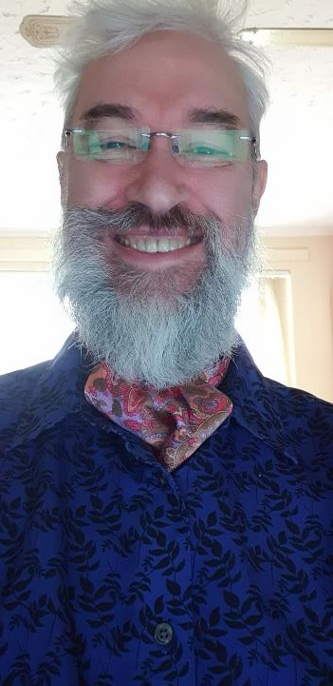




Robert French
Data Dance Teacher with Quorum
Lives in Sunny Glasgow, Scotland
rwlp.french@gmail.com
@sqlbobscot
https://www.linkedin.com/in/rwlpfrench/
https://www.qnrl.com/

Slide 27
bit.ly/3MXxL1g

Slide 28

Notes:
Photo by Francesco Ungaro: https://www.pexels.com/photo/aircraft-flying-over-snowy-forest-in-morning-6105980/
This session is not going to in depth its going to be an overview of various topics

Slide 29

Notes:
Photo by Fernando Rodrigues on Unsplash

Slide 30

Notes:
Photo by Ann H: https://www.pexels.com/photo/pink-jigsaw-puzzle-piece-3482441/
There are going to be some gaps in what I want to talk – next slide

Slide 31

Notes:
Photo by Maria: https://www.pexels.com/photo/clear-hour-glass-on-golden-frame-5357088/
AS I do not have time

Slide 32


Notes:
Photo by Content Pixie on Unsplash
First we are going to talk about stories,
How they affect you, how they are constructed, and what makes a good story

Slide 33


Notes:
Photo by Wan San Yip on Unsplash
Who is your audience

Slide 34


Notes:
Photo by Mika Baumeister on Unsplash
Data

Slide 35

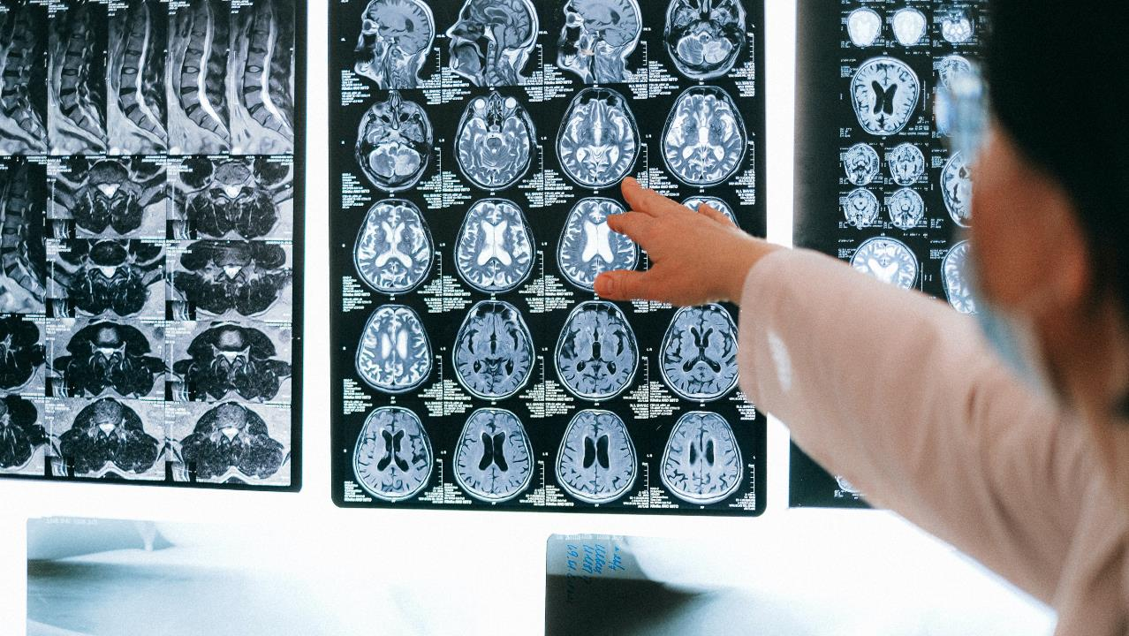
Notes:
Photo by Anna Shvets: https://www.pexels.com/photo/person-holding-silver-round-coins-4226264/
Look at how the brain works

Slide 36

Notes:
Photo by Andrea Piacquadio from Pexels

Slide 37
Notes:
Photo by Content Pixie on Unsplash
First we are going to talk about stories,
How they affect you, how they are constructed, and what makes a good story

Slide 38

Notes:
First part of the workshop we are going to talk about stories and story telling looking a the nuts an bolts so to speak

Slide 39
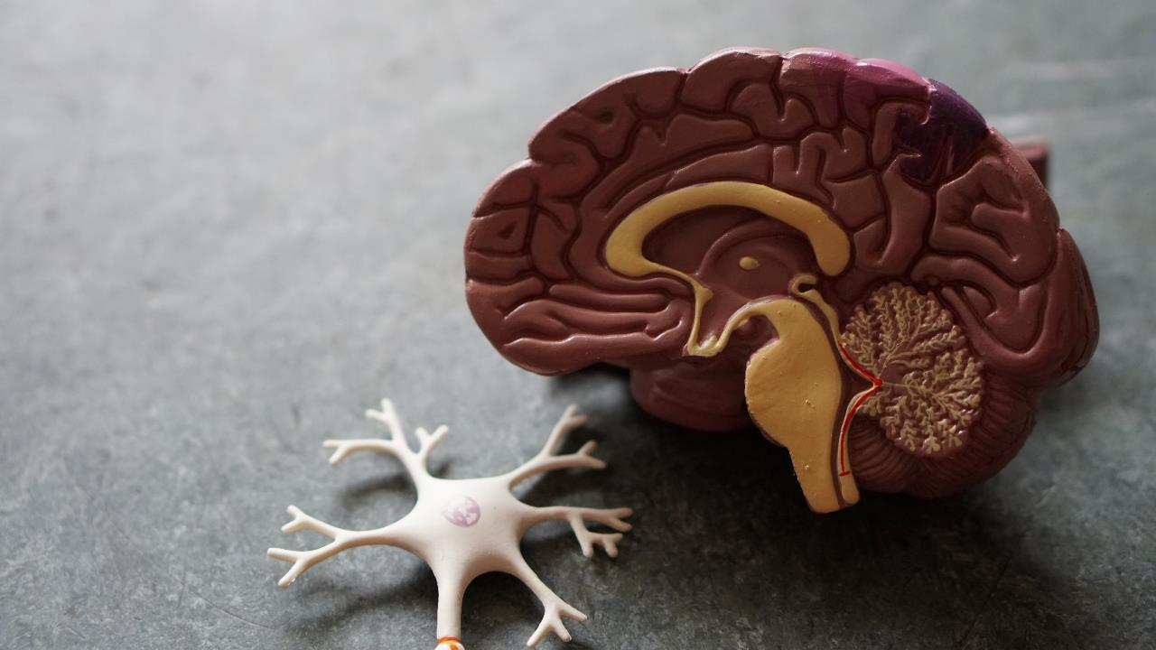
Notes:
Look at how the brain sees and things about things
Photo by Robina Weermeijer on Unsplash

Slide 40
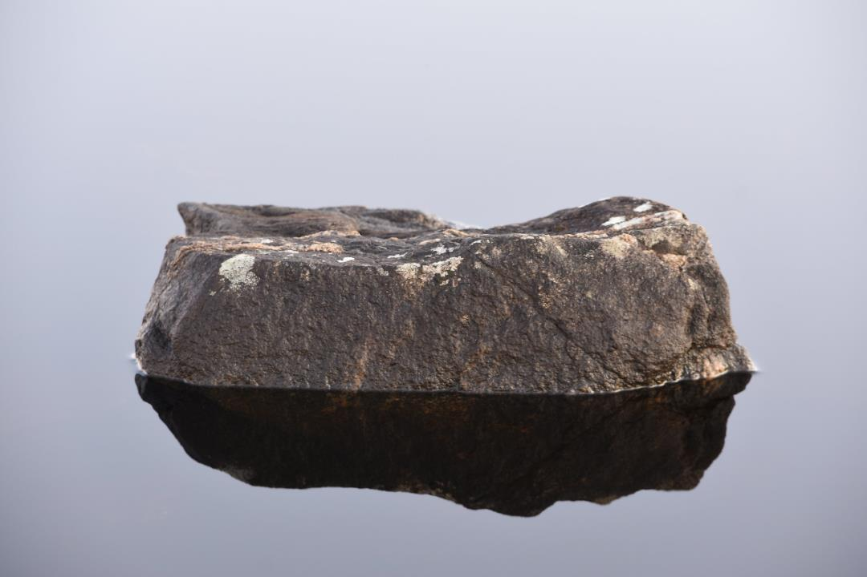
Notes:
Tell the story how created these photos

Slide 41
What happens when you hear or read a story?

Slide 42

Stories
E.g. Books, Films, TV, Audiobooks, etc
They cause oxytocin to be released. (feel good hormone)
Notes:
When we hear stories or have stories read to us, watch a film, or a TV programme like a soap opera or a crime drama
It releases Oxytocin this the same hormone release when we are cuddled or in love,
It make us feel good

Slide 43

Notes:
As the writer describes how the person touching the water, the feeling of how it joins to the fingers, that cooling sensation. You feel it as well
Photo by Chris Leipelt on Unsplash

Slide 44

Notes:
Stories can make our heats beat faster just by being part of the story

Slide 45

Notes:
We get caught up in the emotion of the story

Slide 46
Stories can make us…….
Feel emotions?
See the scenes in our minds eye?
Hear what is described?

Slide 47

Notes:
Lets have a simple story
So get comfortable and I’ll begin
Photo by mentatdgt from Pexels

Slide 48
Notes:
We have a hero
Who is he or she we do not know
Could be luke from star wars
Could be a galant knight
Or boudica she was “kick ass” one might say if I was being political incorrect

Slide 49

Notes:
The hero goes up against the dragon “arrrggghhh”
Think is that the hero is scared of the dragon so……
What happens next?

Slide 50
Notes:
Hero gets scared and exits left, dragon victorious “booo hissss”

Slide 51

Notes:
Hero means mentor, who tells him the real meaning of courage
The mentor talks to the hero, shows him he is strong than he thinks, reveals inner strengths that hero has
May be skills like Story telling?

Slide 52

Notes:
Hero faces dragon a 2nd time

Slide 53
Notes:
This time dragon realises up against a strong person

Slide 54

Notes:
Finally we see the hero has changed and got better in some way
The end

Slide 55

Notes:
Photo by Ann H from Pexels

Slide 56
Climax
Falling Action
Rising
Action
Resolution
Set up Intro to character
Notes:
So what did we have lets look a the story arc
For this story

Slide 57
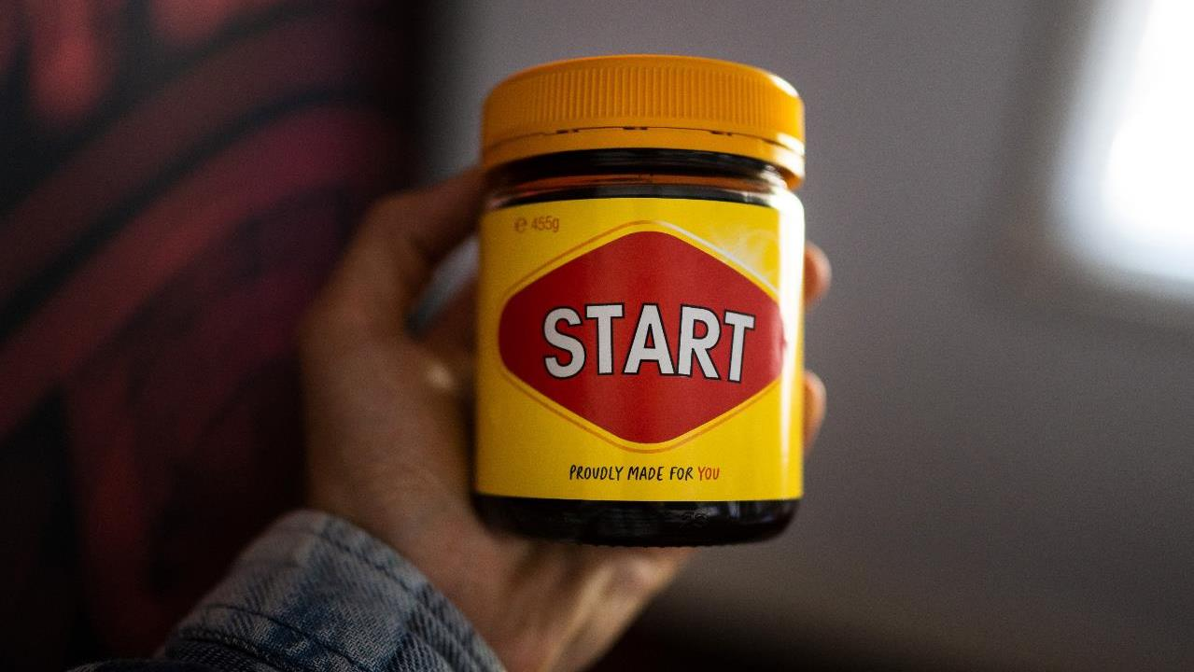
Beginning
Notes:
Photo by Start Digital on Unsplash

Slide 58

Middle
Notes:
Photo by Andrea Piacquadio from Pexels

Slide 59

End
Notes:
Photo by Anton Shuvalov on Unsplash

Slide 60
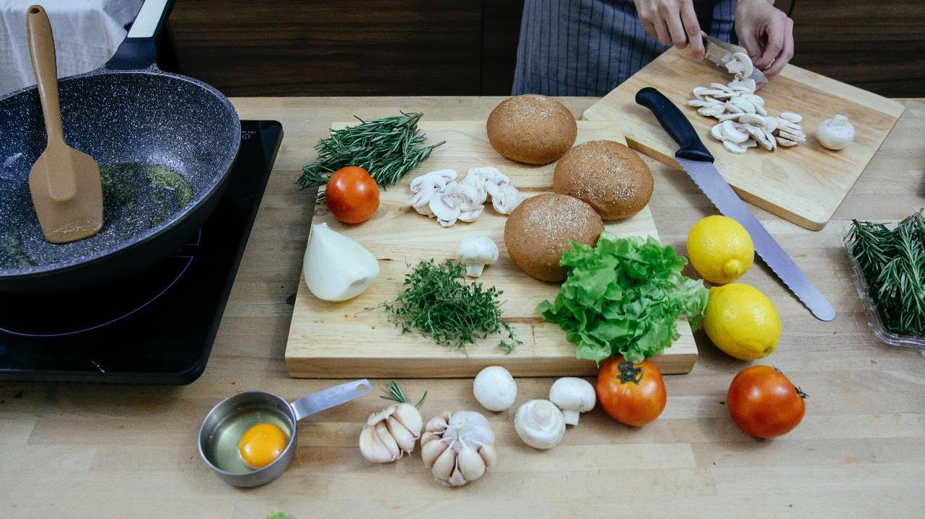
Notes:
What the ingredients for creating a good story
Photo by Katerina Holmes from Pexels

Slide 61
Beginning
Notes:
Photo by Start Digital on Unsplash

Slide 62
Set up the story
Problem?
Opportunity?
Discovery?
Who is the hero?
Who is the mentor?

Slide 63
Remember who your target is?
The audience, are they the hero’s?
Or the data might be the hero you are revealing?

Slide 64
You are the hero’s mentor?
Yoda -> Luke
Alfred -> Batman
You guide them and help them realise their potential.

Slide 65
Middle
Notes:
Photo by Andrea Piacquadio from Pexels

Slide 66
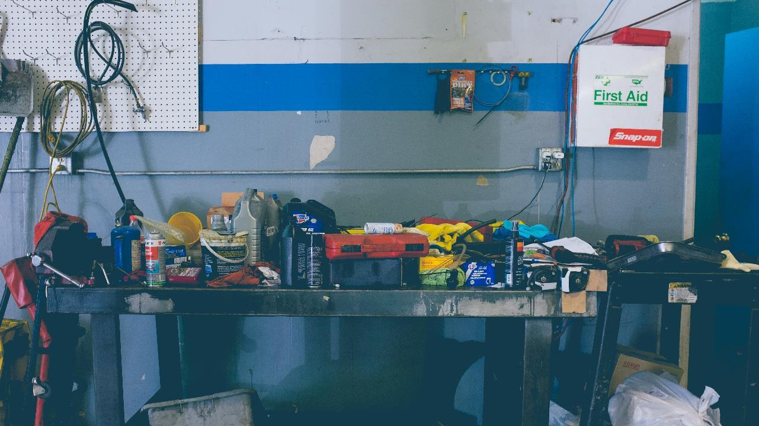
Notes:
Messy middle - this when you layout the show the audience what you are talking about
If its about data this is when you share the data ☺
Photo by NeONBRAND on Unsplash

Slide 67

Notes:
Show the audience what you see
Photo by Antoine Boissonot on Unsplash

Slide 68
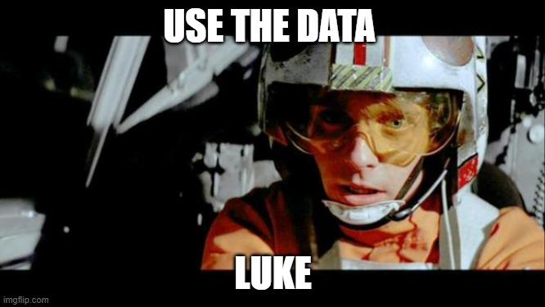
Notes:
Use the data to reinforce your points that you are making
Data is there to help you tell the story to underline the points you are making.

Slide 69
End
Notes:
Photo by Anton Shuvalov on Unsplash

Slide 70

Notes:
What's the call to action?
Photo by Jakob Owens on Unsplash

Slide 71

Notes:
What conclusion should they draw?
It’s the end of the story what should the audience take away?
Photo by Ann H from Pexels

Slide 72

Notes:
How can we use that in a Business Context?
How can these techniques actually be used in a business context?
Photo by Adeolu Eletu on Unsplash

Slide 73

Notes:
Lets just cut that up into sections, Acts if you like.
Photo by Adeolu Eletu on Unsplash

Slide 74
Act one – situation
Opportunity
Value of aluminium has increased significantly.
Challenge
Potholes claims costs increasing each year.

Slide 75
Act Two – complication
Opportunity
Not easy to access the metal in recycling bins
Analysis shows can generate a lot of money for council
Top 3 reclaimers are willing to invest in new processes
Challenge
Can now predict with 80% accuracy when will occur and where
Same sites consistently generate claims against the council
Resurfacing costs less than claims

Slide 76
Act Three – Resolution
Opportunity
Engaging with aluminium reclaiming, with creating income stream
Add to our positive environmental portfolio
Call to action – set up contract with 1st reclaiming company
Challenge
People living in city will see the proactive actions being taken by us
Reduce money spent on claims per year
Call to action – create dedicated road resurfacing crew

Slide 77

Other story arcs are available
Notes:
Other types of story arc are available – Pixar use the three part hero arc quite a bit
Photo by moren hsu on Unsplash

Slide 78
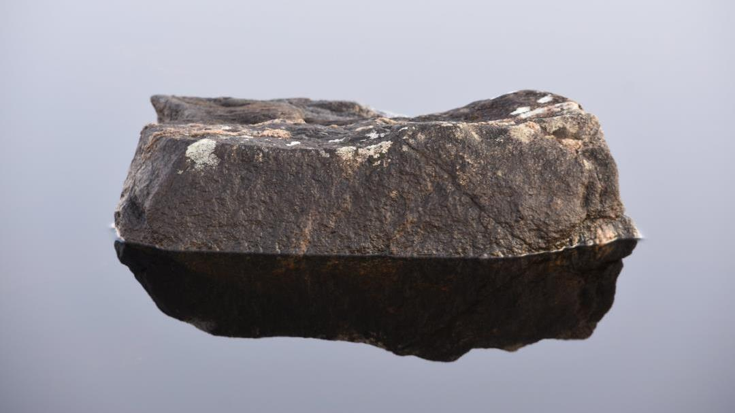
Notes:
Last but not least lets look at Narrative

Slide 79
Narrative
Stories
Data

Slide 80
Define
Narrative

Slide 81

What is the narrative of Little Red Riding Hood?
Notes:
Photo by Šárka Jonášová on Unsplash

Slide 82
Nice girls never listen to
or talk to strangers

Slide 83
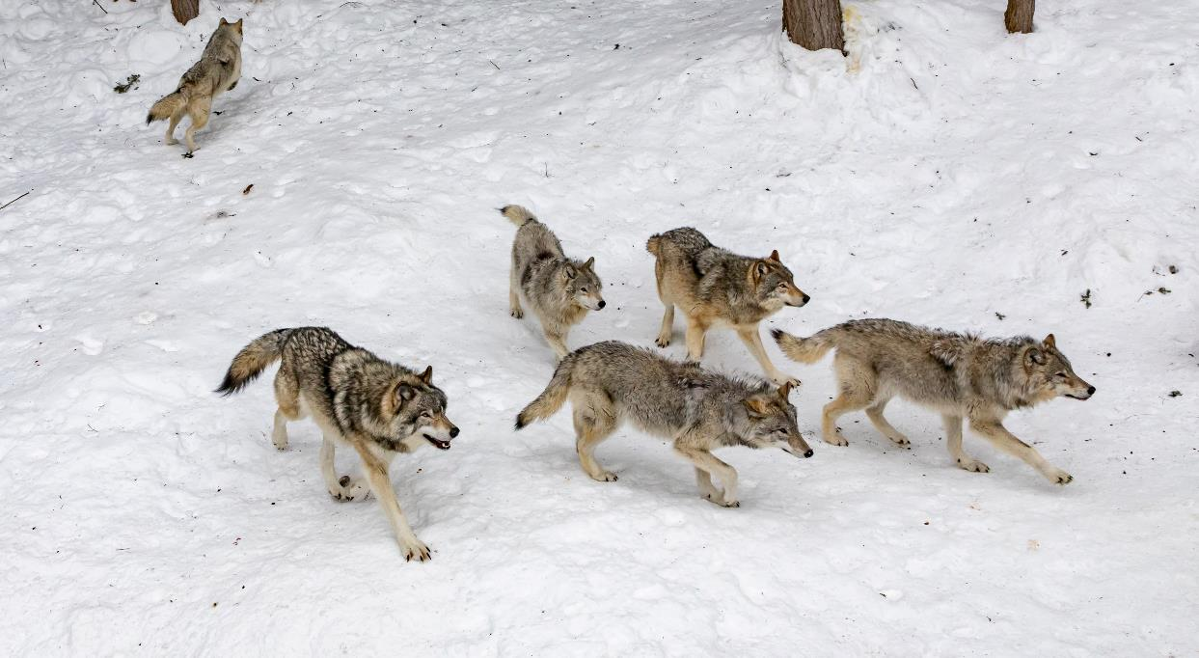
What is the narrative of The Boy Who Cried Wolf?
Notes:
Photo by Eva Blue on Unsplash

Slide 84
If you always lie people will stop believing you.

Slide 85
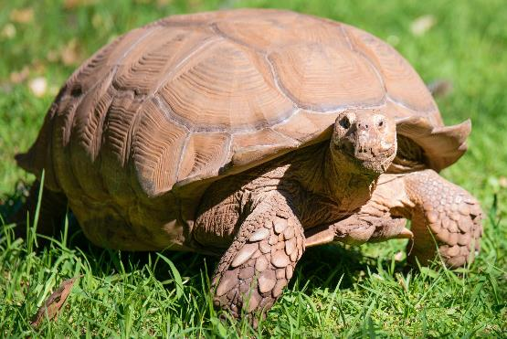
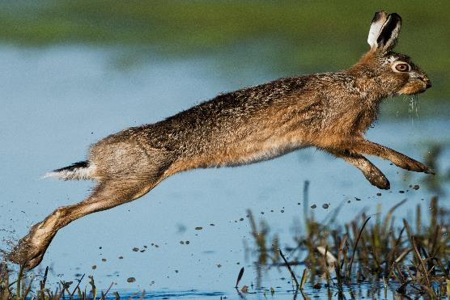
What is the narrative of The Tortoise and the hare?
Notes:
Photo by Joel M Mathey on Unsplash
Photo by Vincent van Zalinge on Unsplash

Slide 86
“Fast” is not always winning but “slow” and steady is winning in the end.

Slide 87


Slide 88
Notes:
Photo by Wan San Yip on Unsplash
Who is your audience

Slide 89

Notes:
What about sorting our audience into different categories?
Photo by Luis Quintero from Pexels

Slide 90

Notes:
Who might be comfortable with data in Glasgow City Audience?
Photo by Ari He on Unsplash

Slide 91
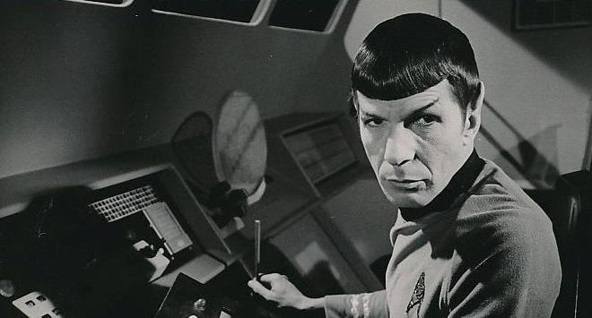
Notes:
Some people are very comfortable with numbers and lots of information
By NBC Television - http://www.ebay.com/itm/SUPERB-1968-Original-Photo-LEONARD-NIMOY-as-SPOCK-in-T-V-STAR-TREK-/261594177355?pt=LH_DefaultDomain_0&amp;hash=item3ce83a5f4b, Public Domain, https://commons.wikimedia.org/w/index.php?curid=35441204

Slide 92
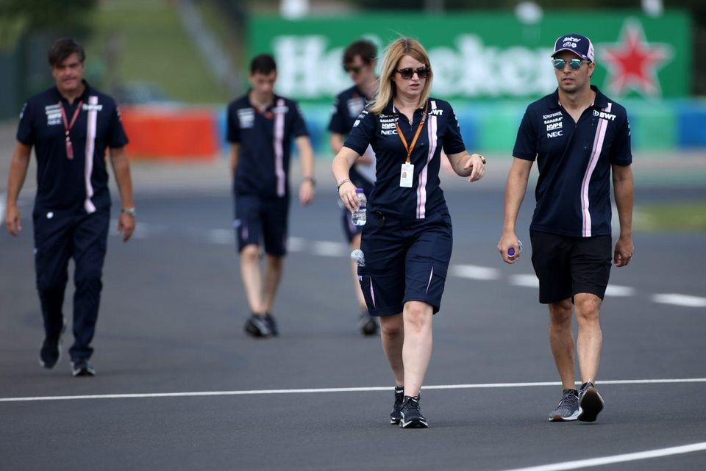
Racing Point F1
Notes:
Bernadette (Bernie) Collins
(now Racing Point F1) becoming their Performance and Senior Strategy Engineer

Slide 93

Notes:
Who is uncomfortable with numbers
Photo by Nik Shuliahin on Unsplash

Slide 94

Notes:
Who is the audience
What are their data literacy levels
Are they a maths graduate
Background in Local government finance
F1 racing mechanic
Meet the inspirational women proving that F1 is ‘more than a man’s world’ (marieclaire.co.uk)
12 Top Car Racing Drivers That Happen to Be Women: 24 Hours of Daytona - Bloomberg
Artist with dyslexia
Photo by RF._.studio from Pexels

Slide 95

Notes:
Thinking of my parents and my partner Jan, none of them that data literate. Which only means the way that data is presented should be different.

Slide 96
205 %
more cyclists traveling into Glasgow city centre.
When compare 2009 with 2018.
https://www.understandingglasgow.com/indicators/transport/cycling

Slide 97
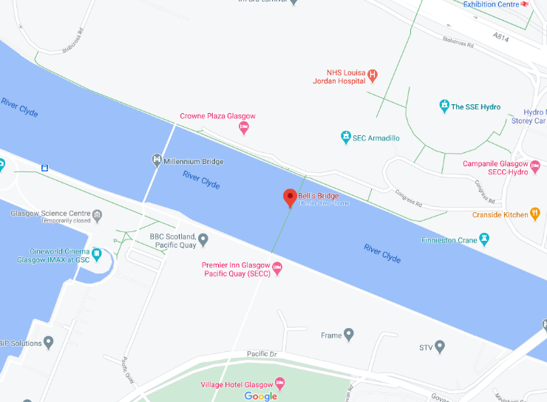
124 more cyclists using Bells Bridge during 2 day survey period in 2018 compared to same period in 2009.

Slide 98
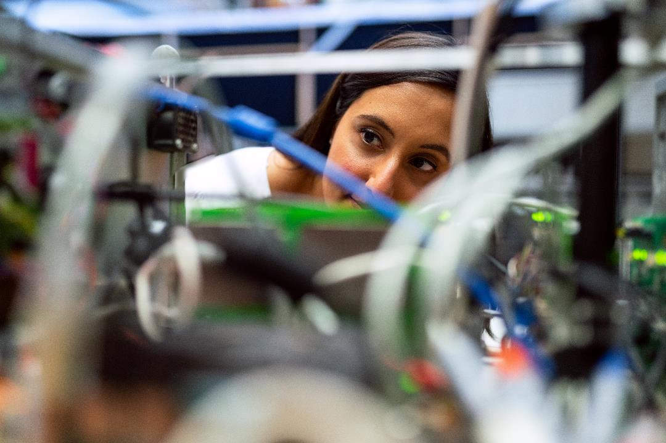
Notes:
What level of detail would an engineer want?
Photo by ThisIsEngineering from Pexels

Slide 99

Notes:
Would a visual artist be as interested in the same level of details and figures. Maybe, its context that matters .
Photo by Brett Sayles from Pexels

Slide 100
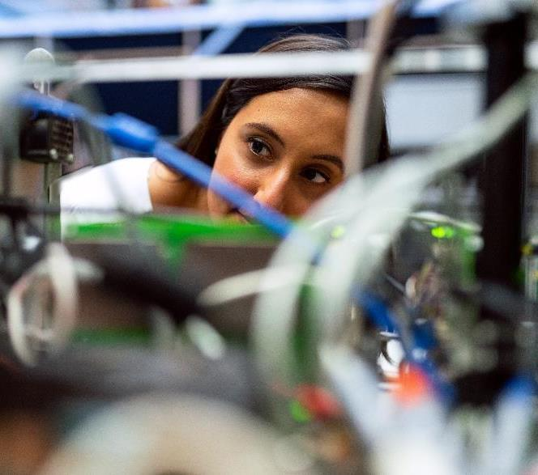

Non-Technical
Technical
Notes:
So if assume Engineer = technical
Artist = non technical
Engineer = would prefer high level of detail to explore – street level view to see the detail of what is happening which is more focused on specific details
Artist = happy the overview – which gives a flavour of the data

Slide 101

Personas
Notes:
https://dribbble.com/shots/1938508-Free-User-pics

Slide 102
“…nobody uses them…
why should we use them?”
Notes:
This might be something some people are thinking?

Slide 103

Notes:
Some people think it’s a good idea, some do not lets look at which organisations use personas
https://www.pexels.com/photo/banking-business-checklist-commerce-416322/

Slide 104


Slide 105
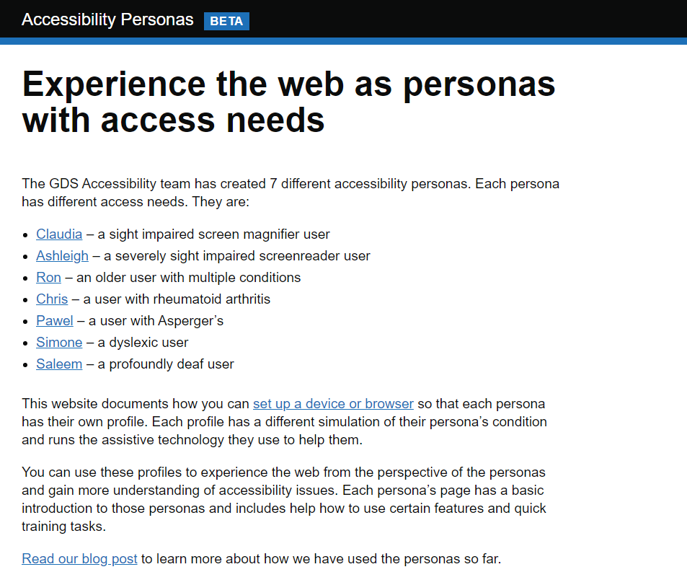
Notes:
https://alphagov.github.io/accessibility-personas/

Slide 106
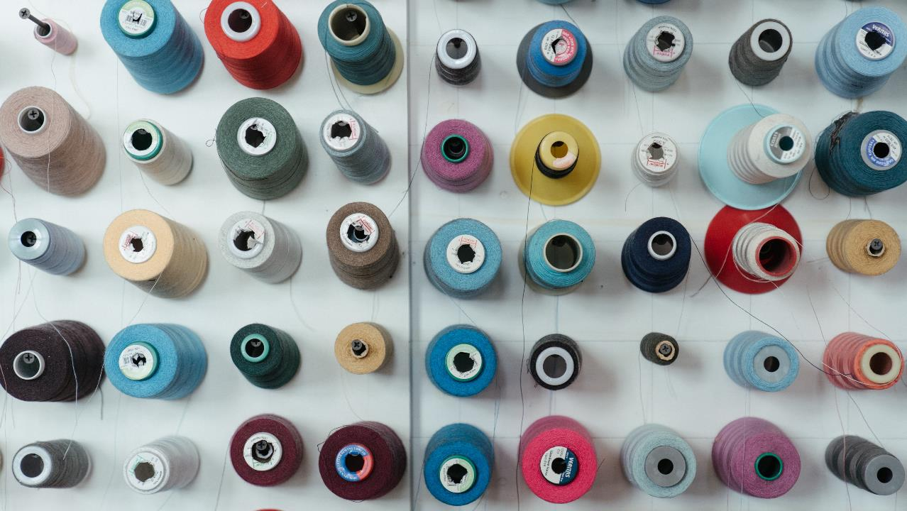
Define your audience?
Notes:
Many humans like to sort things into different categories
Photo by cottonbro from Pexels

Slide 107
How ?
Notes:
Many humans like to sort things into different categories
Photo by cottonbro from Pexels

Slide 108
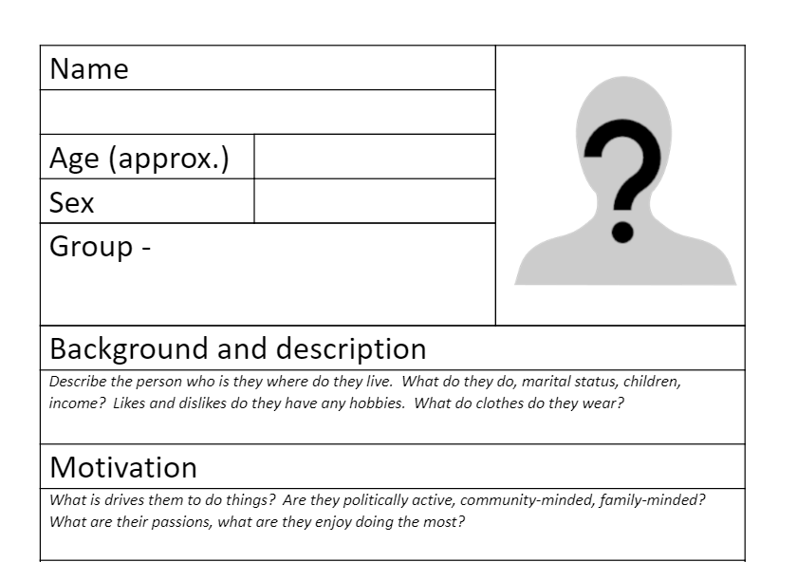

Slide 109
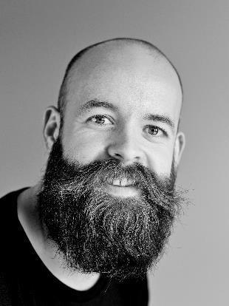


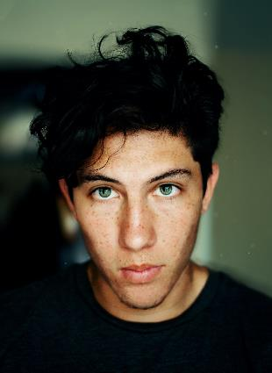

https://unsplash.com/s/photos/face
Notes:
Photo by Imansyah Muhamad Putera on Unsplash
Photo by Omid Armin on Unsplash
Photo by Erik Lucatero on Unsplash
Photo by Craig McKay on Unsplash

Slide 110

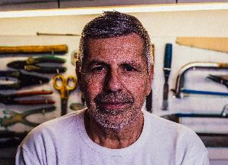
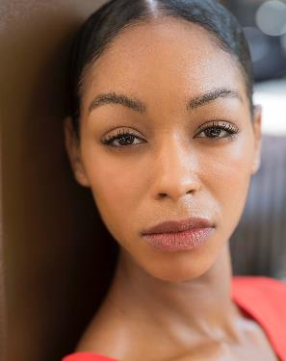

https://www.pexels.com/search/face/
Notes:
Photo by Italo Melo from Pexels
Photo by Juan Pablo Serrano Arenas from Pexels
Photo by SHAHBAZ AKRAM from Pexels
Photo by Moose Photos from Pexels

Slide 111
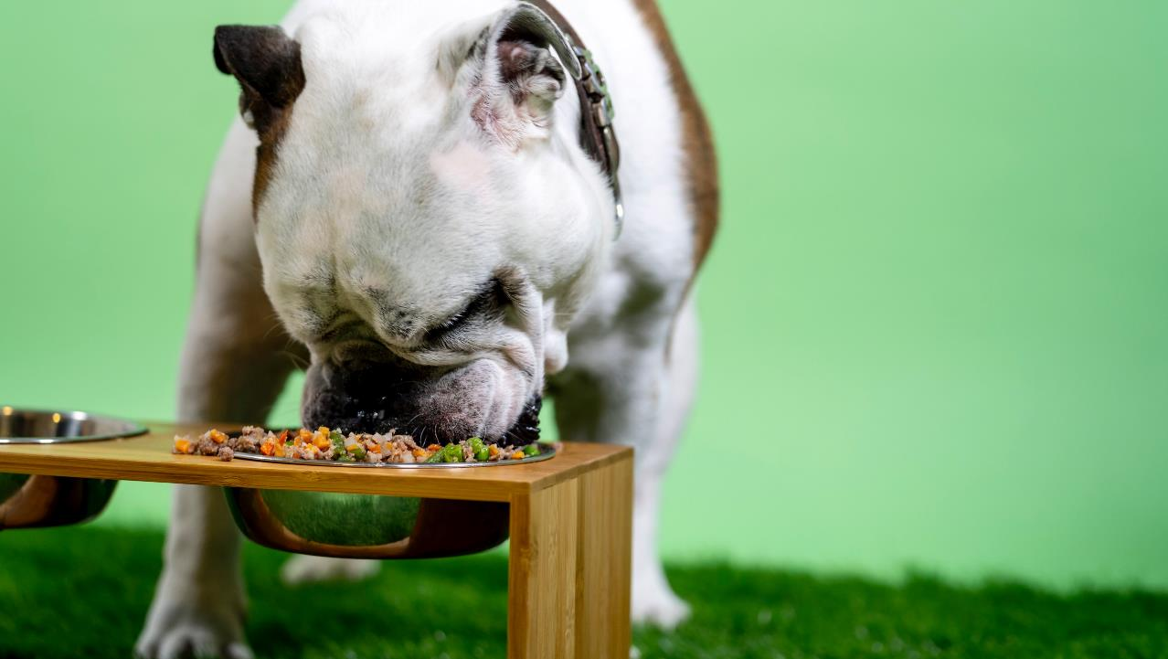
Notes:
Photo by Kabo on Unsplash
Yes I do eat my own dog food

Slide 112
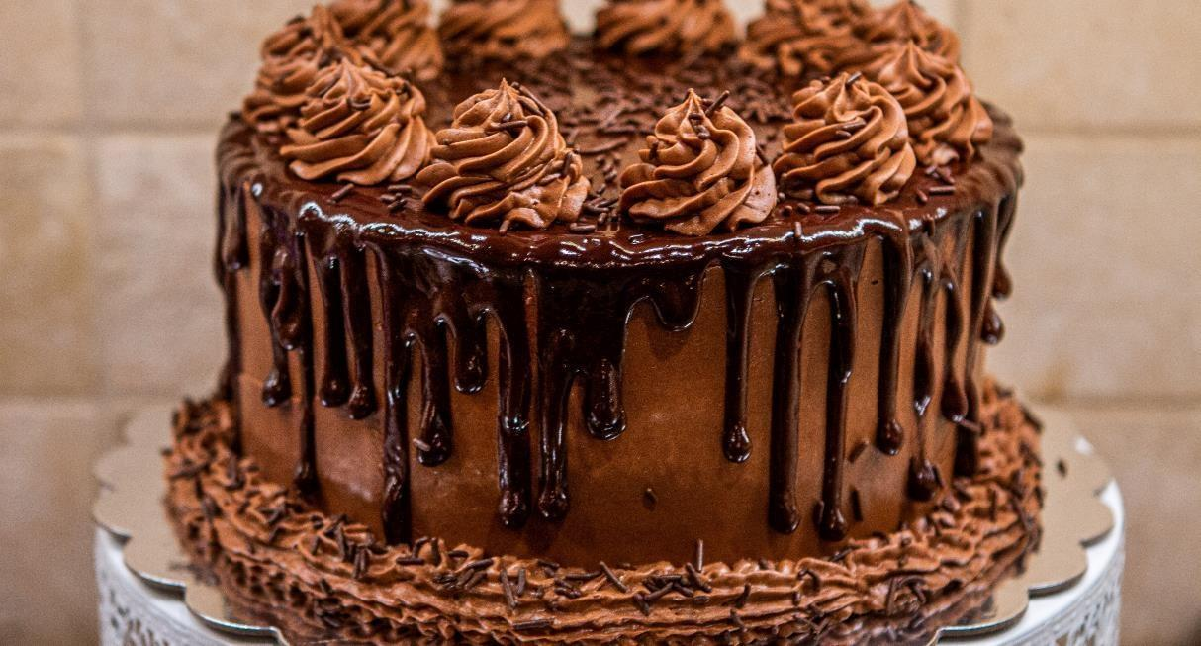
Notes:
As in all the good cookery shows here’s is one I prepared earlier
Photo by Phinehas Adams on Unsplash

Slide 113
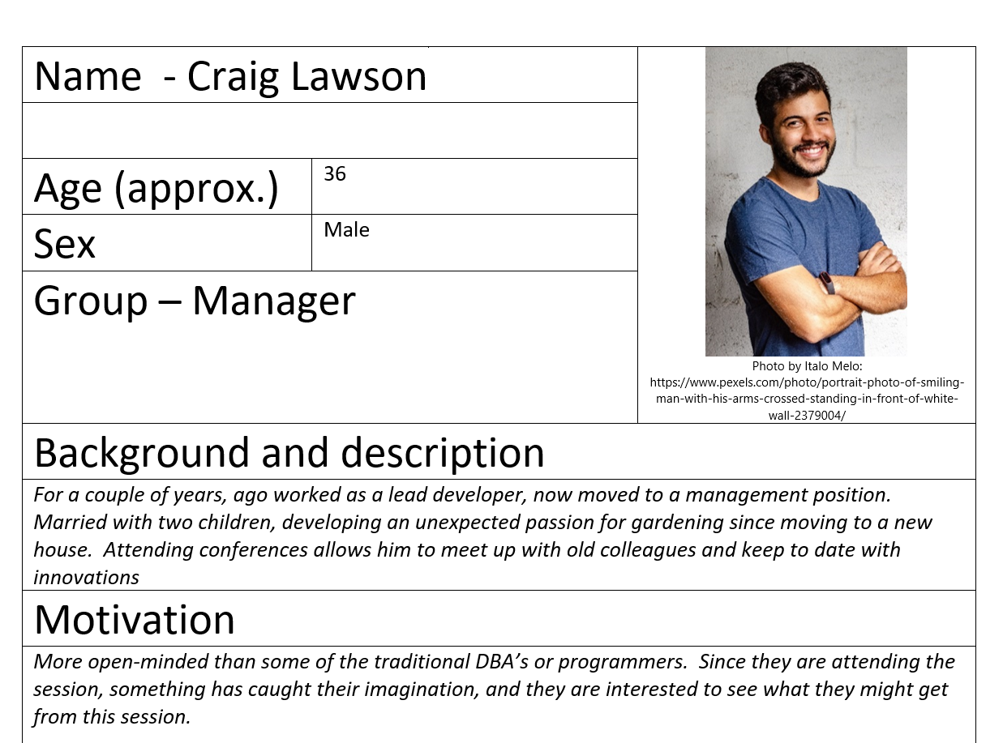

Slide 114
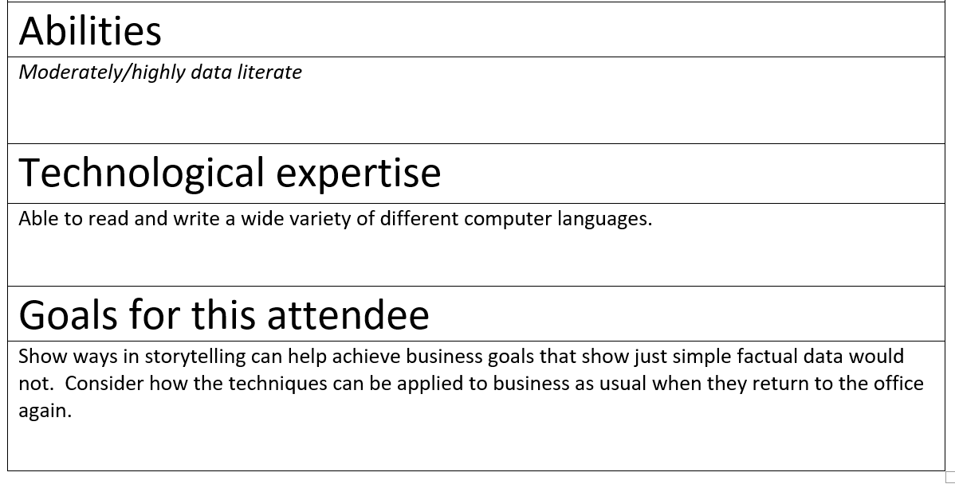

Slide 115
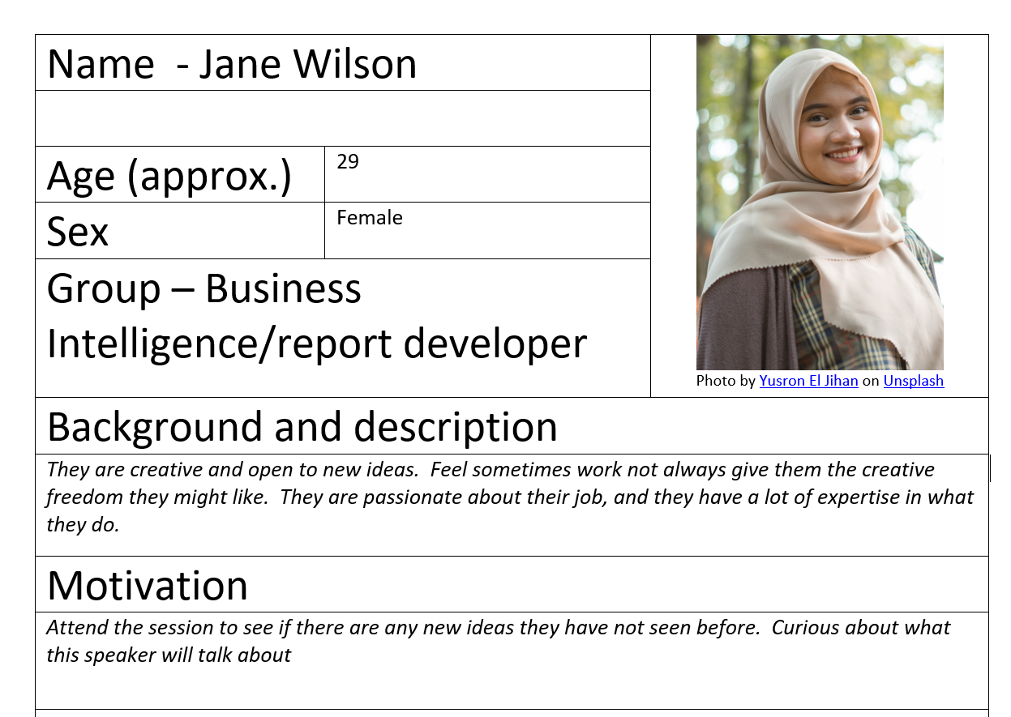

Slide 116
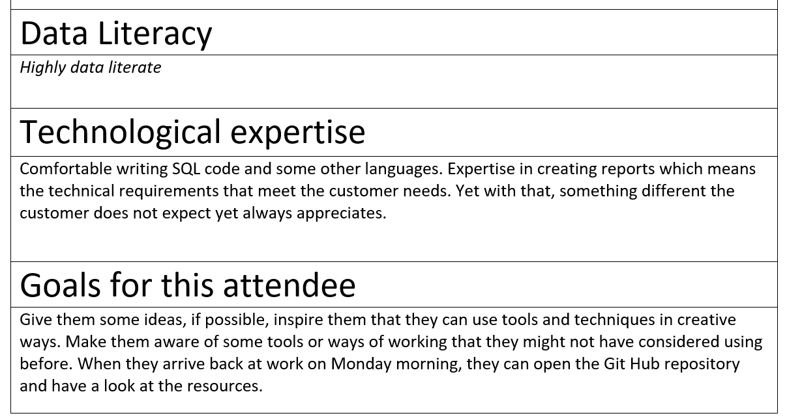

Slide 117
Notes:
Tell the story how created these photos

Slide 118
Notes:
Photo by Mika Baumeister on Unsplash
Data

Slide 119
Question
1) X + D = DX
2) X + D = XD
Hint X = 10 D = 500
https://www.romannumerals.org/converter

Slide 120


Slide 121
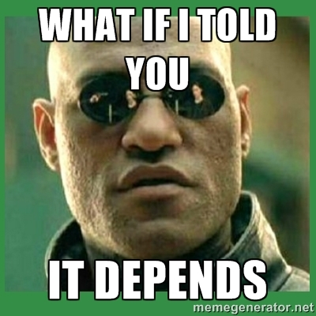

Slide 122
1) X + D = DX ü
10 + 500 = 510
2) “X” + “D” = “XD” ü

Slide 123

Notes:
Photo by Markus Spiske on Unsplash
We all know that computers will not allow an Integer to be added a string, yes you can one has to be converted

Slide 124

Notes:
Do you know your dataset as well as you know your bank account?
Photo by Karolina Grabowska from Pexels

Slide 125

Notes:
Photo by Tim Stief on Unsplash
Do you know simple things like the
lowest value and the highest value, what is the average value does that look right?
Bed blocking story – Jen Stirrup

Slide 126

Notes:
Photo by Florian Schmidinger on Unsplash
Not buy a house without a survey, or would you?

Slide 127

This Photo by Unknown Author is licensed under CC BY-NC-ND
Notes:
Yet make business decisions based on data you do not know?
Known unknowns

Slide 128

Notes:
Photo by Markus Spiske on Unsplash
Do not panic what are we suggesting?

Slide 129

Notes:
Photo by Pavan Trikutam on Unsplash
Are there obvious pattern's in the data

Slide 130
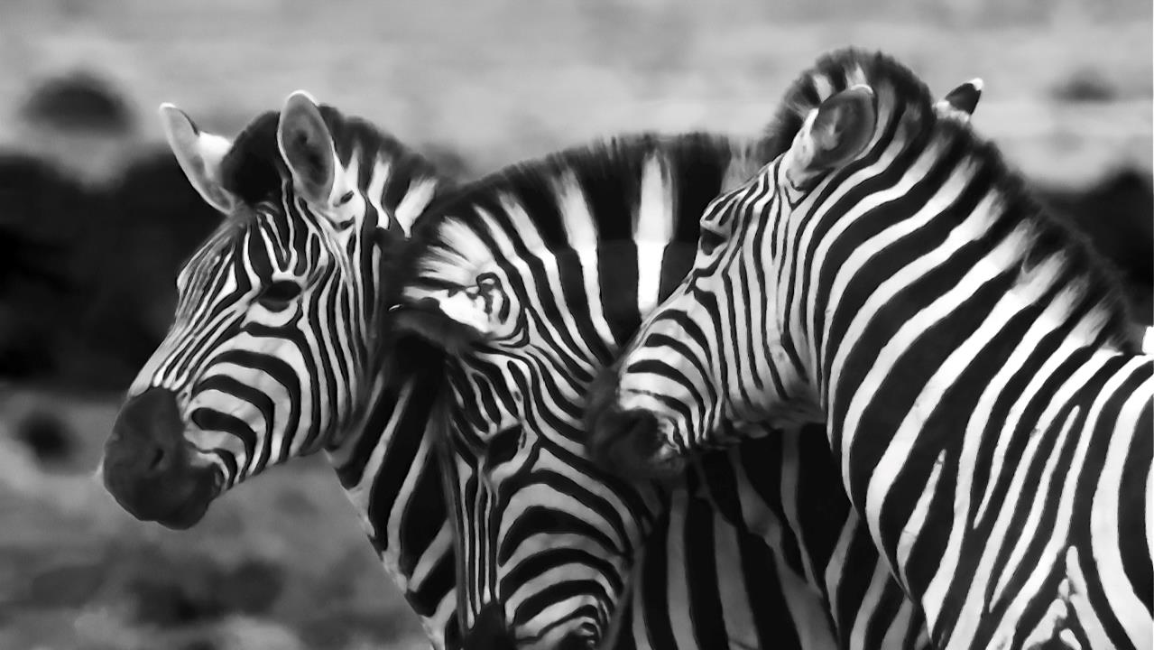
Notes:
Photo by Etienne Steenkamp on Unsplash
Do these patterns make sense if selling ice cream you expect to sell more when it is warmer, not in the winter, unless get a Christmas spike?

Slide 131

Notes:
Photo by Todd Diemer on Unsplash
Are there highs and lows in your data?
Can you see unexpectedly high or values which you cannot explain?

Slide 132

Notes:
Photo by Etienne Steenkamp on Unsplash
Are those “outliers” those bits off data to do not fit the ups and downs why are they so different do you know about them
These affect forecasts

Slide 133
Example questions to ask
Min
Max
Average
How many records
How much detail

Slide 134
Hierarchies
Year
Month
Day

Slide 135
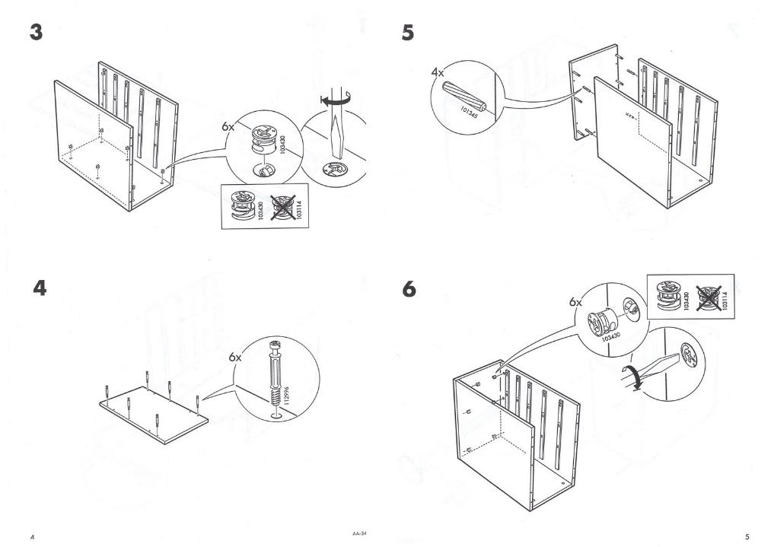
Notes:
How do you profile data?

Slide 136

Notes:
You can use Power BI

Slide 137

Is your data Quantitative?
Discrete – How many ducks in the pond in June 2021

Slide 138
Is your data Quantitative?
Continuous – What is the weight of all the ducks in the pond in June 2021

Slide 139
Is your data Qualitive or Categorical
Is your data Nominal, can it be ranked, is there any correlations…..

Slide 140
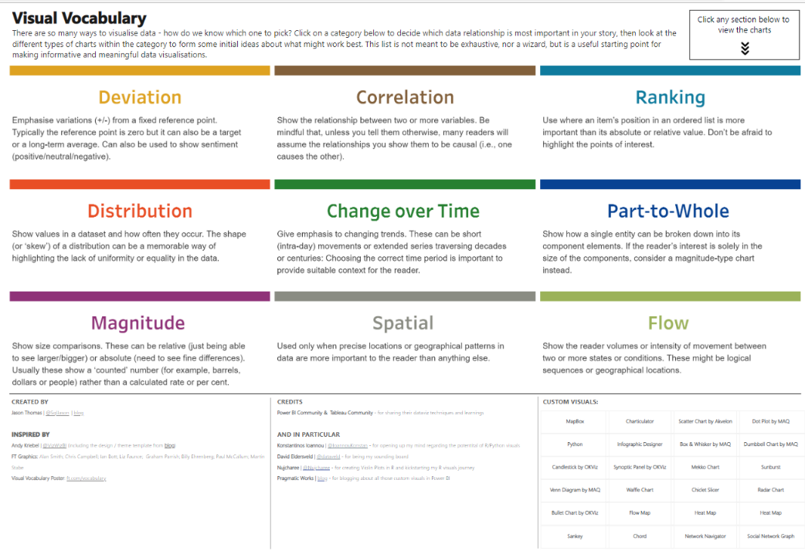

Slide 141
Notes:
Tell the story how created these photos

Slide 142
Notes:
Photo by Anna Shvets: https://www.pexels.com/photo/person-holding-silver-round-coins-4226264/
Look at how the brain works

Slide 143

Notes:
Its not easy to learn a new skill
Photo by The Ride Academy on Unsplash

Slide 144

Notes:
How to do we learn? – sometimes we feel there is so much to learn !
Photo by Tim Gouw on Unsplash

Slide 145
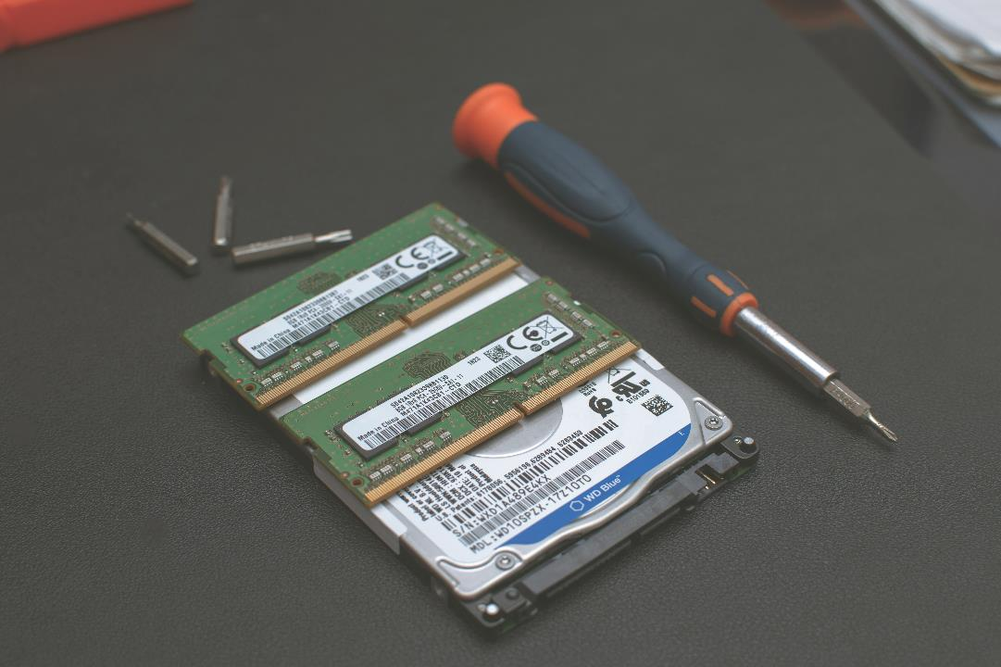
Notes:
Two types of memory
Photo by Heliberto Arias on Unsplash

Slide 146
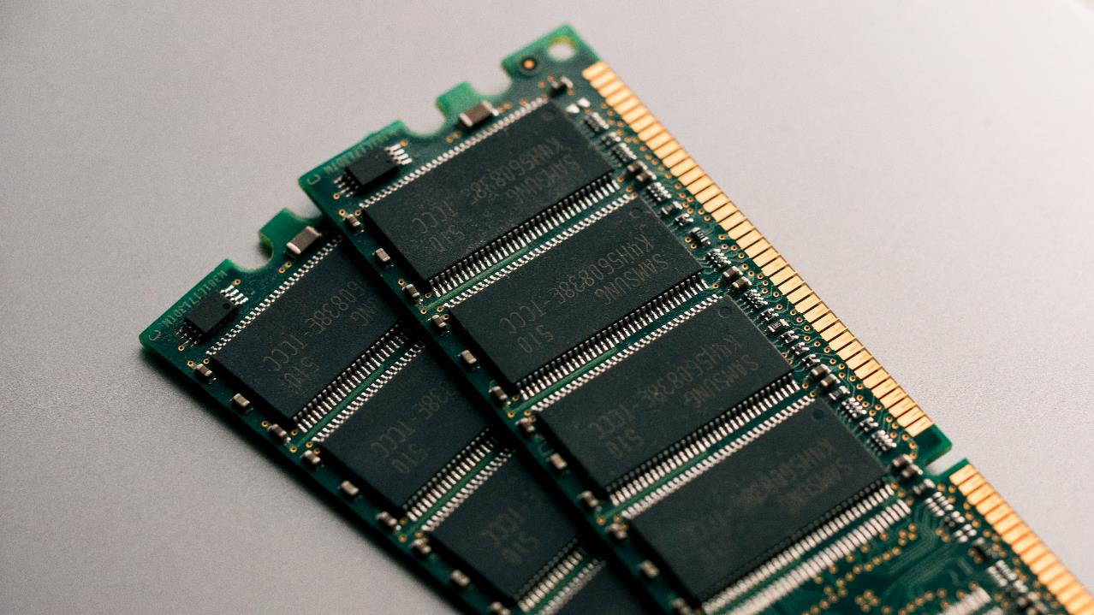
Notes:
Working memory - which is store term more of scratch pad more than anything
Photo by Harrison Broadbent on Unsplash

Slide 147

Notes:
Long term memory – which is where we store
Photo by Azamat Esenaliev from Pexels

Slide 148

Notes:
For the example we are going to assume three slots
Photo by Tony Hand on Unsplash

Slide 149
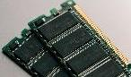

“Computer Ram”
Slot one
Slot two
Slot three
“Hard Drive”

Slide 150



“Working memory”
Slot one
Slot two
Slot three
“Long Term memory”

Slide 151
“Working memory”
Slot one
Slot two
Slot three
“Long Term memory”

Slide 152

“Working memory”
Slot one
Slot two
Slot three
“Long Term memory”

Slide 153

“Working memory”
Slot one
Slot two
Slot three
“Long Term memory”

Slide 154
“Working memory”
Slot one
Slot two
Slot three
“Long Term memory”

Slide 155

Notes:
How do we see things or more to the point how does the brain recreate image in our mind?
Photo by Edi Libedinsky on Unsplash

Slide 156




Notes:
https://www.kenrockwell.com/tech/how-we-see.htm
We only see small part of an image at any one time. Our brains that create an image in our brains so the many images we are constantly being exposed to.

Slide 157
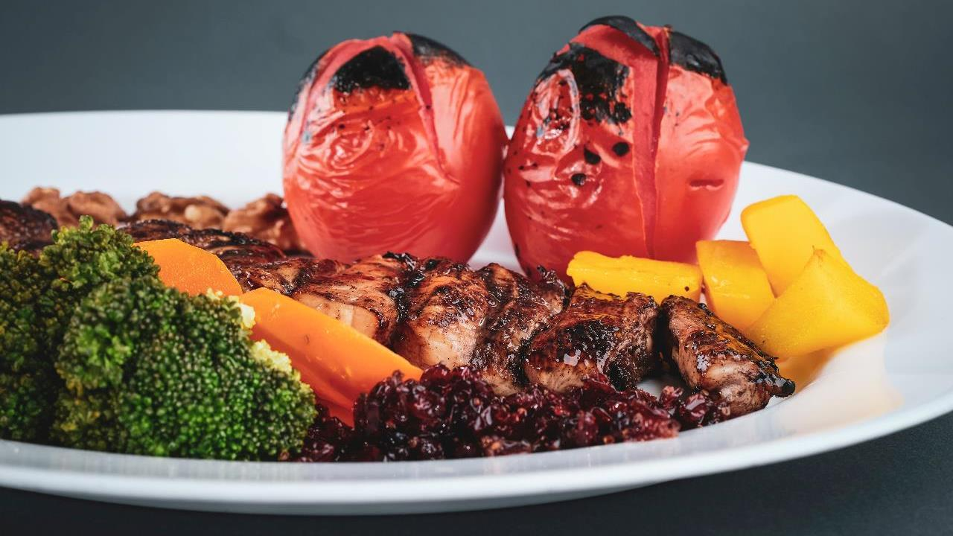
Look at this image
Notes:
Photo by Sam Moqadam on Unsplash

Slide 158

Notes:
Photo by Sam Moqadam on Unsplash

Slide 159


Slide 160


Slide 161


Slide 162
Notes:
Photo by Sam Moqadam on Unsplash

Slide 163

Notes:
When we look at something we do not always see the whole picture
Photo by Bhumil Chheda on Unsplash

Slide 164
And?
So what?
Notes:
Some might be saying this in their head

Slide 165
Z scanning

Slide 166





Slide 167
F
scanning

Slide 169

Notes:
Or thinking what has this got to do with data story telling
Photo by Robert Nagy from Pexels

Slide 170


Slide 171

Notes:
https://www.smashingmagazine.com/2016/09/reducing-cognitive-overload-for-a-better-user-experience/

Slide 172
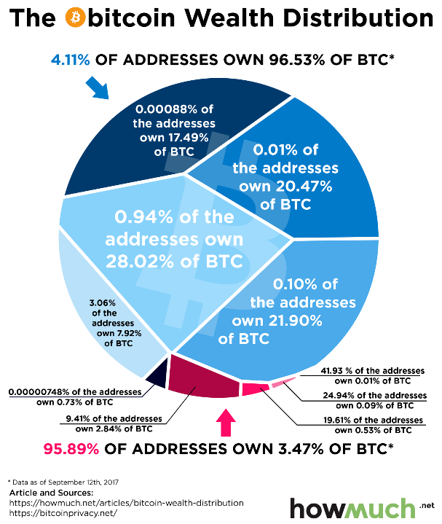

Slide 173
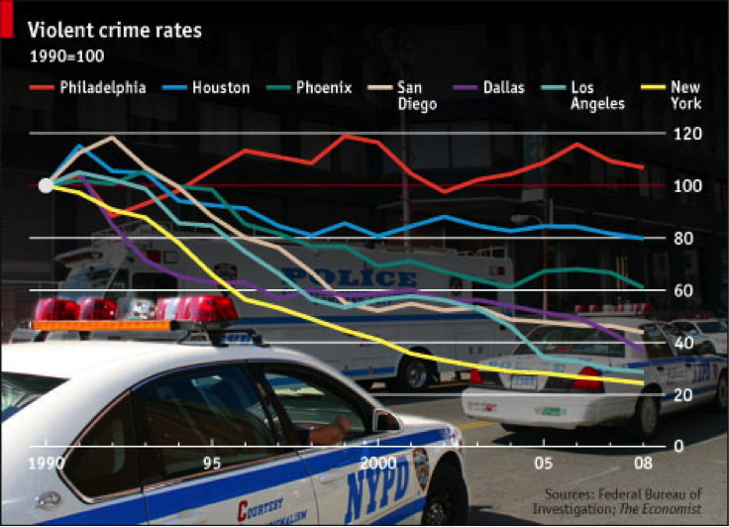
https://uxmag.com/articles/four-cognitive-design-guidelines-for-effective-information-dashboards
Notes:
https://uxmag.com/articles/four-cognitive-design-guidelines-for-effective-information-dashboards

Slide 174
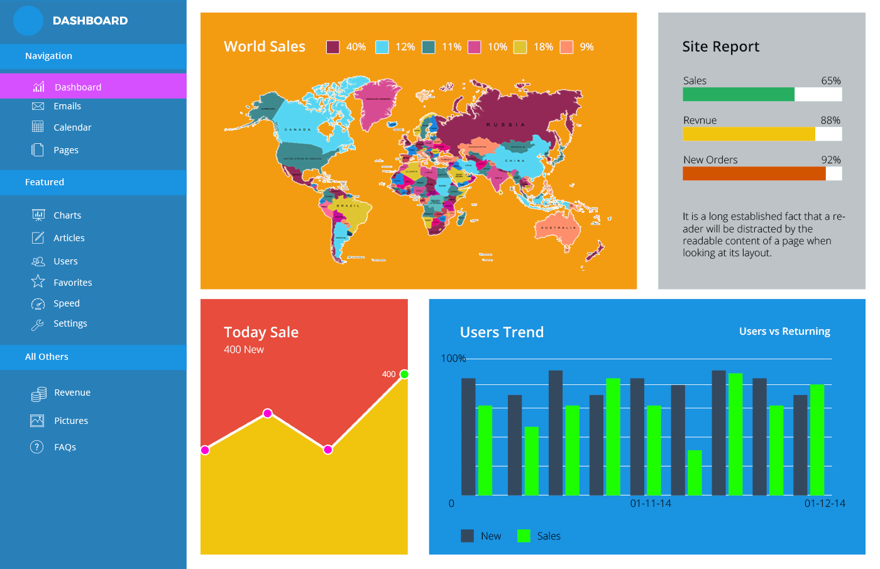
10 Dashboard Design Errors And How To Avoid Them (fusioncharts.com)10 Dashboard Design Errors And How To Avoid Them (fusioncharts.com)

Slide 175


Slide 176

There are only THREE slots in my working memory
Notes:
Photo by Atul Choudhary from Pexels

Slide 177
Notes:
Tell the story how created these photos

Slide 178

Notes:
Photo by Markus Winkler on Unsplash

Slide 179

Notes:
Image by Brett Hondow from Pixabay

Slide 180
Preattentive Attributes
Notes:
Image by Brett Hondow from Pixabay

Slide 181

Notes:
Photo by wu yi on Unsplash
Test time going to time you to see how long it takes to complete this task

Slide 182
1 | 3 | 9 | 3 | 3 | 7 | 7 | 0 | 1 | 9 | 7 | 5 | 5
9 | 5 | 0 | 3 | 1 | 3 | 2 | 0 | 3 | 3 | 7 | 8 | 9
3 | 3 | 1 | 7 | 9 | 5 | 5 | 0 | 5 | 1 | 5 | 9 | 6
5 | 2 | 4 | 8 | 2 | 3 | 4 | 5 | 6 | 3 | 5 | 1 | 9
7 | 0 | 1 | 3 | 1 | 0 | 1 | 3 | 2 | 1 | 7 | 3 | 4
1 | 9 | 4 | 9 | 3 | 1 | 5 | 2 | 4 | 1 | 3 | 1 | 9
3 | 5 | 0 | 8 | 4 | 8 | 2 | 6 | 8 | 8 | 5 | 2 | 2
3 | 1 | 5 | 1 | 5 | 3 | 9 | 1 | 0 | 1 | 7 | 9 | 5
3 | 3 | 3 | 6 | 1 | 7 | 0 | 1 | 2 | 7 | 1 | 3 | 0
Notes:
12 nines

Slide 183

Notes:
Photo by Nguyen Dang Hoang Nhu on Unsplash
Did that feel like a test?

Slide 184
1 | 3 | 9 | 3 | 3 | 7 | 7 | 0 | 9 | 1 | 7 | 5 | 5 | 8
9 | 5 | 0 | 3 | 1 | 3 | 2 | 0 | 3 | 3 | 7 | 8 | 9 | 2
3 | 3 | 1 | 7 | 9 | 5 | 5 | 0 | 5 | 1 | 5 | 3 | 6 | 4
5 | 2 | 4 | 8 | 2 | 3 | 4 | 5 | 6 | 9 | 5 | 1 | 5 | 4
7 | 0 | 1 | 9 | 1 | 0 | 1 | 3 | 2 | 1 | 7 | 3 | 4 | 4
1 | 5 | 4 | 3 | 3 | 1 | 5 | 2 | 4 | 1 | 3 | 1 | 8 | 9
3 | 5 | 0 | 8 | 4 | 8 | 2 | 6 | 8 | 8 | 5 | 2 | 2 | 5
3 | 1 | 5 | 9 | 5 | 3 | 1 | 1 | 0 | 1 | 7 | 6 | 5 | 0
9 | 3 | 1 | 1 | 0 | 5 | 5 | 0 | 6 | 5 | 1 | 7 | 1 | 9
2 | 5 | 3 | 0 | 1 | 8 | 1 | 2 | 9 | 3 | 1 | 3 | 2 | 4
Notes:
12 nines

Slide 185

Notes:
Photo by Ben White on Unsplash
Did that version seem easier?
No the nines where not all in the same place ;-)

Slide 186

Notes:
Some of you have questions
Why is he doing this?
Why did the colour make it much easier

Slide 187

Notes:
Colin Ware in his book Information visualisation for design

Slide 188
Form

Slide 189
Length

Slide 190
Width

Slide 191
Orientation

Slide 192
Curvature

Slide 193
Size

Slide 194
Shape

Slide 195
Added Marks

Slide 196
Enclosure

Slide 197
Blur

Slide 198
Spatial Grouping

Slide 199
Colour

Slide 200
Hue

Slide 201
Intensity

Slide 202
Spatial
Position

Slide 203
2D Position

Slide 204
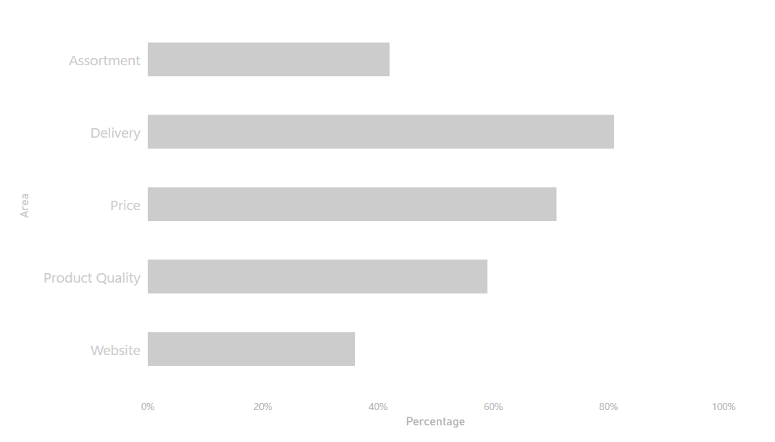
Website survey results
Notes:
Here is some website survey results

Slide 205
What are the best performers?

Slide 206
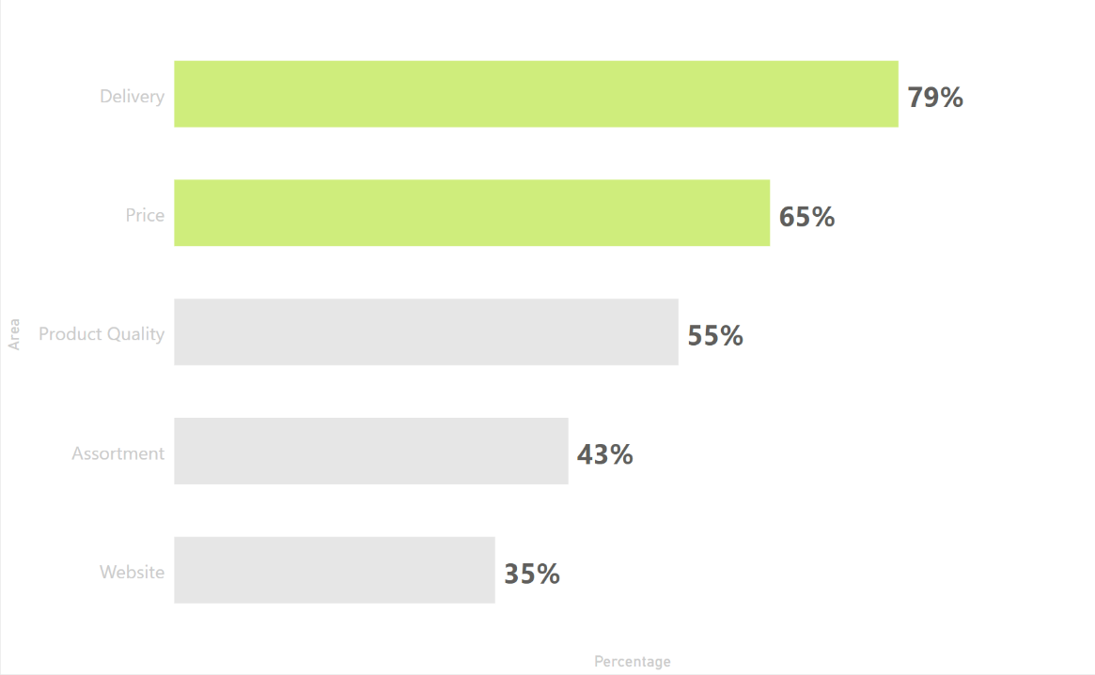
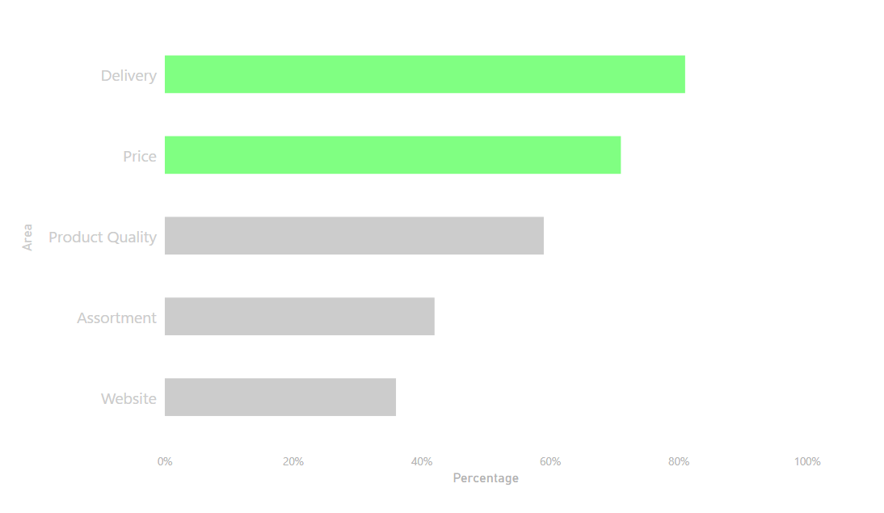

Slide 207
What are the worst performers?

Slide 208
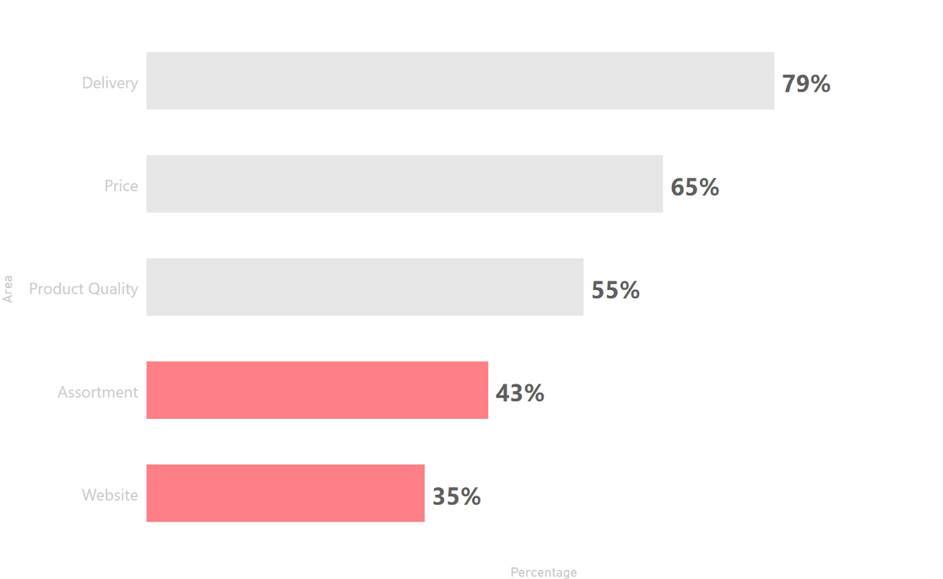

Slide 210

Gestalt principles

Slide 212
Proximity

Slide 214
Symmetry

Slide 216
Similarity

Slide 218
Enclosure

Slide 220
Closure

Slide 222
Continuity

Slide 224

Similarity

Slide 225

Anomaly

Slide 226


Slide 227

Notes:
Photo by Nick Fewings on Unsplash

Slide 228

Closure
Notes:
Lets look at some real life

Slide 229

Closure
Notes:
Even though the lines are dashed we see them as a whole
Forming a T shape
Showing way around the roundabout

Slide 230

Continuation
Notes:
Your eye is drawn form the A to Z and them along the logo

Slide 231

Continuation

Slide 232

Figure and ground
By Bryan Derksen - Original image Cup or faces paradox.jpg uploaded by Guam on 28 July 2005, SVG conversion by Bryan Derksen, CC BY-SA 3.0, https://commons.wikimedia.org/w/index.php?curid=1733355
Notes:
Vase or two faces?
By Bryan Derksen - Original image Cup or faces paradox.jpg uploaded by Guam on 28 July 2005, SVG conversion by Bryan Derksen, CC BY-SA 3.0, https://commons.wikimedia.org/w/index.php?curid=1733355

Slide 233

Notes:
this chart is not following the Gestalt Principle of Continuity

Slide 234

Notes:
Chart rearranged to better follow the Gestalt Principle of Continuity / Continuatoin

Slide 235

Notes:
Chart rearranged to follow the Gestalt Principles of Continuity and Similarity

Slide 236


Slide 237


Number of male vs female employees
Notes:
Similarity

Slide 238


Employees born in UK vs born elsewhere
Notes:
Similarity
Note that there a several levels to this report with are easy to see without being obvious
What are they?

Slide 239

Notes:
Photo by Andrea Piacquadio: https://www.pexels.com/photo/tired-female-student-lying-on-book-in-library-3808080/
Some of you might be thinking nobody uses these techniques in real life

Slide 240


Slide 241

Notes:
Photo by Andrew Neel: https://www.pexels.com/photo/white-flag-2330507/

Slide 242


Slide 243


Slide 244


Slide 245


Slide 246


Slide 247

Notes:
Photo by That's Her Business on Unsplash

Slide 248

Homework
https://youtu.be/hVimVzgtD6w
Notes:
https://youtu.be/hVimVzgtD6w
2:35

Slide 249
Notes:
Photo by Andrea Piacquadio from Pexels

Slide 250

Notes:
image by <a href="http://www.freeimageslive.co.uk/free_stock_image/typographyjpg" target="_blank"> freeimageslive.co.uk - creator</a>

Slide 251
How does font this feel?

Slide 252
How does this font feel?

Slide 253
How does this font feel?

Slide 254
How does this font feel?

Slide 256
Is this easy to read?

Slide 257
Is this easy to read?

Slide 258
Is this easy to read?

Slide 259
Is this easy to read?

Slide 260
Is this easy to read?

Slide 262

Girls in white dresses with blue sashes
Bright copper kettles and
warm woollen mittens
Cream coloured ponies and crisp apple strudels

Slide 263
Colours can have emotions associated with them.

Slide 264
Passion, Love, Blood, Danger, Strength
Romantic, Feminine, Love, Sensitivity, Exciting
Optimism, Sunshine, Confidence, Attention, Success
Health, Growth, Peace, Vitality, Wealth
Energy, Happiness, Success, Warmth, Creativity
Trust, Serenity, Peace, Communication, Sadness
Royalty, Majesty, Mystery, Spirituality, Luxury
Organic, Honest, Natural, Simple, Wholesome
Compromise, Neutral, Balance, Conservative, Frustration
Elegance, Power, Luxury, Mystery, Sorrow
Pure, Simple, Innocence, Virginity, Minimalism

Slide 265
Colours can suggest temperatures.

Slide 266

Notes:
Some colours can have feelings of temperature associated with them
https://choelscherart.com/wp-content/uploads/Color-Wheel-basic.jpg

Slide 267
Choose colours carefully

Slide 268

Notes:
We need to choose carefully what colours we are going to use
Photo by Victoriano Izquierdo on Unsplash

Slide 269

Context of the colour is key.

Slide 270

Notes:
Red is good that’s the cool of oxygenated blood
Pink cheeks and rosey skin means you are warm and comfortable
Photo by Karolina Grabowska from Pexels

Slide 271
Green skin is not sign of good health

Slide 272

Notes:
The Ultimate Guide To Virtual Trading And Stock Market Simulators | Bankrate

Slide 273

Notes:
https://globalvoices.org/2015/07/13/the-risky-roller-coaster-ride-that-is-chinas-stock-market/
https://www.bbc.co.uk/news/av/business-33464903
“China's stock markets explained in 50 seconds. Why, on Chinese share price display screens, does red mean that a share's price has gone up, rather than down, as it does in other countries where green means that a share price has risen?”

Slide 274

Notes:
https://slate.com/business/2014/11/japan-is-in-a-recession-why-is-its-unemployment-so-low.html

Slide 276

Notes:
Photo by Yan Krukov: https://www.pexels.com/photo/group-of-people-doing-fist-bump-7793141/
Stories work

Slide 277

Notes:
Photo by Sharon McCutcheon on Unsplash
Story got me a 25% pay rise in one job

Slide 278

Notes:
Photo by Tima Miroshnichenko: https://www.pexels.com/photo/businessman-looking-at-employee-5439368/
Stories that I have ready for job interviews

Slide 279

Notes:
https://app.powerbi.com/view?r=eyJrIjoiY2VlMjg1MmQtMzFhZi00NzY1LThjZTUtMWI2MjM5ODFhYjUzIiwidCI6ImJkNjlkMzZiLTE3ZGQtNDczZC05MWM2LWNlYzI4ODI5YWI1MyIsImMiOjh9
We created a story about potholes to pitch for a data story telling workshop

Slide 280

Notes:
Photo by toine G on Unsplash
The stories about improving SQL Server speed performance

Slide 281

Notes:
Photo by Brett Jordan on Unsplash

Slide 282

Notes:
Photo by John Arano on Unsplash

Slide 283

Notes:
Photo by the blowup on Unsplash

Slide 284
bit.ly/3MXxL1g

Slide 285

https://evals.datagrillen.com/evals.aspx
Notes:
Photo by Lukas: https://www.pexels.com/photo/man-in-black-formal-suit-jacket-653429/https://evals.datagrillen.com/evals.aspx

Slide 286
Robert French
Data Dance Teacher with Quorum
Lives in Sunny Glasgow, Scotland
rwlp.french@gmail.com
@sqlbobscot
https://www.linkedin.com/in/rwlpfrench/
https://www.qnrl.com/

